Slide 1
Wednesday

Slide 2
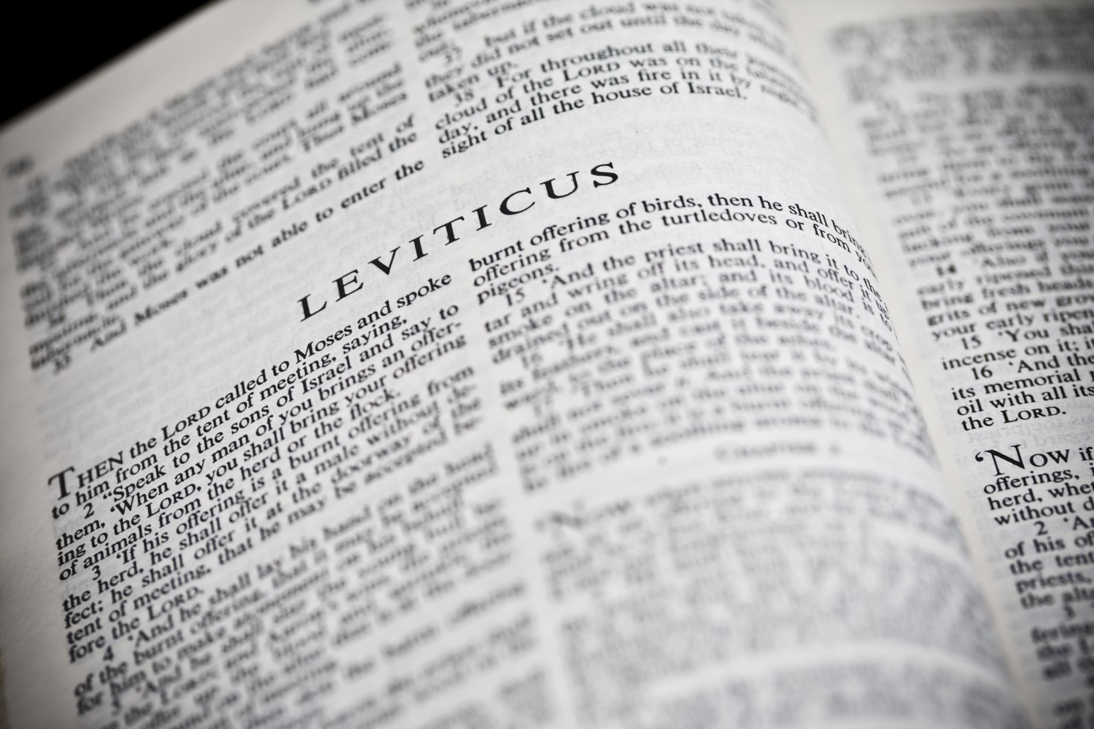
You Shall Be Holy …
A Study of the Book of Leviticus
Two Main Objectives
Encourage reading of “harder” texts
Strive for a closer relationship with God
La Vista - 2016
Joe Works
201-398-8438
Lilpreacherjoe@aol.com

Slide 3
Lessons from Leviticus
1-7. Sacrifices ☹ Aroma & Atonement
8-10. Priesthood ☹ Hebrews
11. Eating animals ☹ Mark 7:19
Gentile lesson ☹ Acts 10; 11; 15 ^{(Lev 20:25-26)}
12. Childbirth ⁽⁸⁾ ☹ Luke 2:22-24
13-14.Leprosy ^{(13:46)} ☹ Mark 1:40-45
15. Discharges ☹ Mark 5:25-34
16. Atonement ☹ Hebrews 9:7, 12, 25-28
Linen cloths ☹ John 20:5-6
17-18.Gentile laws ☹ Acts 15:19-29; 21:25

Slide 4
Lessons from Leviticus
Do not profane God’s name: 18:21; 19:12; 20:3; 21:6; 22:2, 32
19. 10 commandments ☹ Ex 20; Dt 5; Matt 19:18-19
20. Purity ⁽²¹⁻²³⁾ ☹ I Thessalonians 4:3-8
21. Leading men ⁽¹⁻⁸⁾ ☹ I Tim 3:1-13
Dead parents ⁽¹¹⁾ ☹ Luke 9:59-60
22. The eunuch ⁽⁴⁾ ☹ Dt 23:1; Isa 56:3-8; Acts 8
23. 3 Annual Feasts ☹ I Corinthians 5:7-8
24. Blasphemy ☹ Matthew 12:22-32
25. Year of Jubilee ☹ Isaiah 61  Luke 4:16-21
26. Curses ☹ II Chronicles 36:21
Blessings ☹ II Cor 6:16; Rev 21:7
27. Vows to God ☹ Matthew 15:1-8

