Slide 2
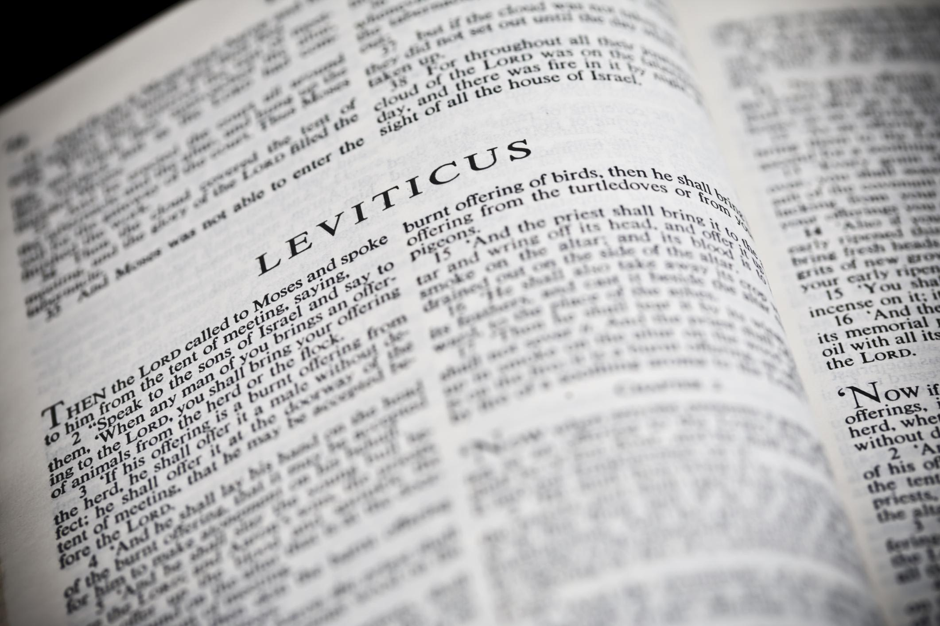
You Shall Be Holy …
A Study of the Book of Leviticus
Two Main Objectives
Encourage reading of “harder” texts
Strive for a closer relationship with God
La Vista - 2016
Joe Works
201-398-8438
Lilpreacherjoe@aol.com

Slide 3
The Day of Atonement (Yom Kippur)
Leviticus 16

Slide 4
The Day of Atonement
Atonement = To cover or purge or ransom
Holy (Solemn) Day Leviticus 23:26-32
Day of Affliction Leviticus 16:29-31
Day of Rest
Day of Cleansing from sin
Overview: Enter the Holy Place with blood (16:3)

Slide 5
The Day of Atonement
Events Of The Day
Atonement for the High Priest
Bath & change clothes (white) (16:4)
Sacrifice 1 bull for himself/family (16:6,11)
Offer incense in the Most Holy Place (16:12-13)
Sprinkle the blood on mercy seat (16:14)

Slide 6
The Day of Atonement
Events Of The Day
Atonement for the People
Sacrifice 1 goat for the nation (16:5, 8-9, 15)
Sprinkle the blood on mercy seat (16:15-16)
Sprinkle blood on the altar of burnt offering (16:17-20)
Let 1 goat go as a scapegoat into the wilderness (16:8, 10, 20-22)

Slide 7
Christ: High Priest & Sacrifice
Tabernacle is a copy Heb 8:5; 9:23
Tabernacle is a foreshadowing Heb 9:11-15; 10:1
Christ came as High Priest Heb 9:11
Christ came as our atonement Heb 9:28
Coming into God’s presence Heb 9:24
Leviticus 16 allows us to understand what Christ did in making God accessible (Heb 10:19-20)

Slide 8
The High Priest’s Garments
Elaborate “royal” clothing for his role Ex 28
Simpler “slave” clothing for atoning work Lev 16:4
Christ, as King, emptied himself Phil 2:5-11
Atonement being made, he changed again Lev 16:23

Slide 9
The High Priest’s Garments
23 “Then Aaron shall come into the tabernacle of meeting, shall take off the linen garments which he put on when he went into the Holy Place, and shall leave them there. (Lev 16:23)

Slide 10
The High Priest’s Garments
23 “Then Aaron shall come into the tabernacle of meeting, shall take off the linen garments which he put on when he went into the Holy Place, and shall leave them there. (Lev 16:23)

Slide 11
The High Priest’s Garments
23 “Then Aaron shall come into the tabernacle of meeting, shall take off the linen garments which he put on when he went into the Holy Place, and shall leave them there. (Lev 16:23)
5 And he, stooping down and looking in, saw the linen cloths lying there; yet he did not go in.
6 Then Simon Peter came, following him, and went into the tomb; and he saw the linen cloths lying there,
7 and the handkerchief that had been around His head, not lying with the linen cloths, but folded together in a place by itself. (John 20:5-7)

Slide 12
The High Priest’s Garments
23 “Then Aaron shall come into the tabernacle of meeting, shall take off the linen garments which he put on when he went into the Holy Place, and shall leave them there. (Lev 16:23)
5 And he, stooping down and looking in, saw the linen cloths lying there; yet he did not go in.
6 Then Simon Peter came, following him, and went into the tomb; and he saw the linen cloths lying there,
7 and the handkerchief that had been around His head, not lying with the linen cloths, but folded together in a place by itself. (John 20:5-7)

Slide 13
The High Priest’s Garments
23 “Then Aaron shall come into the tabernacle of meeting, shall take off the linen garments which he put on when he went into the Holy Place, and shall leave them there. (Lev 16:23)
5 And he, stooping down and looking in, saw the linen cloths lying there; yet he did not go in.
6 Then Simon Peter came, following him, and went into the tomb; and he saw the linen cloths lying there,
7 and the handkerchief that had been around His head, not lying with the linen cloths, but folded together in a place by itself. (John 20:5-7)

Slide 14
The High Priest’s Garments
23 “Then Aaron shall come into the tabernacle of meeting, shall take off the linen garments which he put on when he went into the Holy Place, and shall leave them there. (Lev 16:23)
5 And he, stooping down and looking in, saw the linen cloths lying there; yet he did not go in.
6 Then Simon Peter came, following him, and went into the tomb; and he saw the linen cloths lying there,
7 and the handkerchief that had been around His head, not lying with the linen cloths, but folded together in a place by itself. (John 20:5-7)

