Slide 2
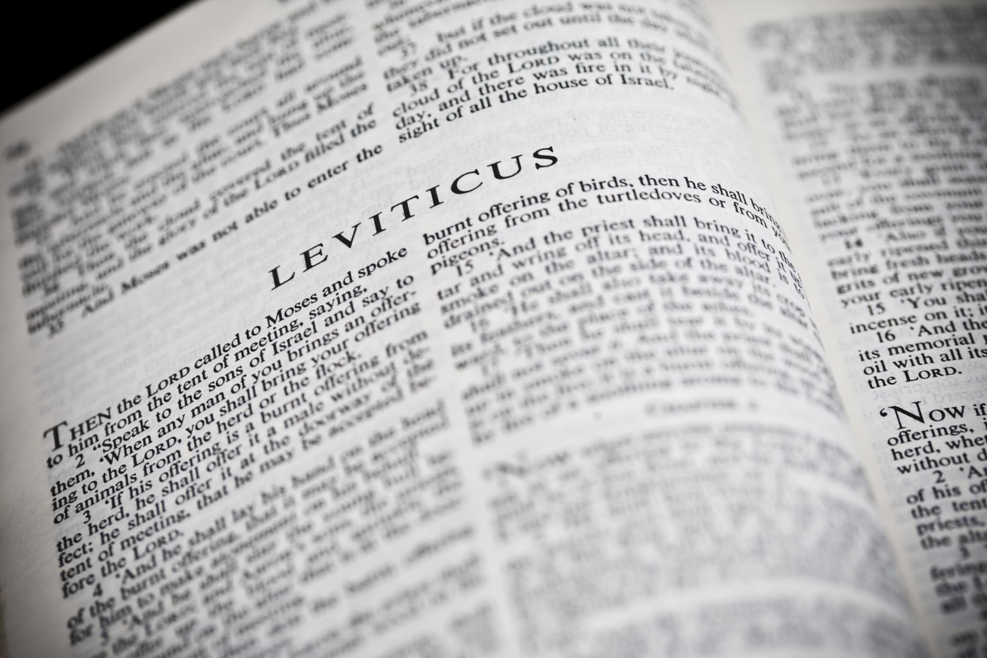
You Shall Be Holy …
A Study of the Book of Leviticus
Two Main Objectives
Encourage reading of “harder” texts
Strive for a closer relationship with God
La Vista - 2016
Joe Works
201-398-8438
Lilpreacherjoe@aol.com

Slide 3
“Love your neighbor”
Leviticus 19:18

Slide 4
2nd Greatest Commandment
A way of life ☹ Lev 19:13-18
Friends & enemies ☹ Matthew 5:43-48
Neighbors > Money ☹ Matthew 19:16-22
Neighbors > Sacrifices ☹ Mark 12:28-34;
☹ Matt 22:34-40
What Mr. Rogers asked ☹ Luke 10:25-37
Love one another ⁽²²⁾ ☹ Beloved John ⁽¹⁰⁾
A debt never paid ☹ Romans 13:8-10
Love ☑ serve ☹ Galatians 5:13-6:10
The royal law ☹ James 2:1-13; 1:27

