Slide 2
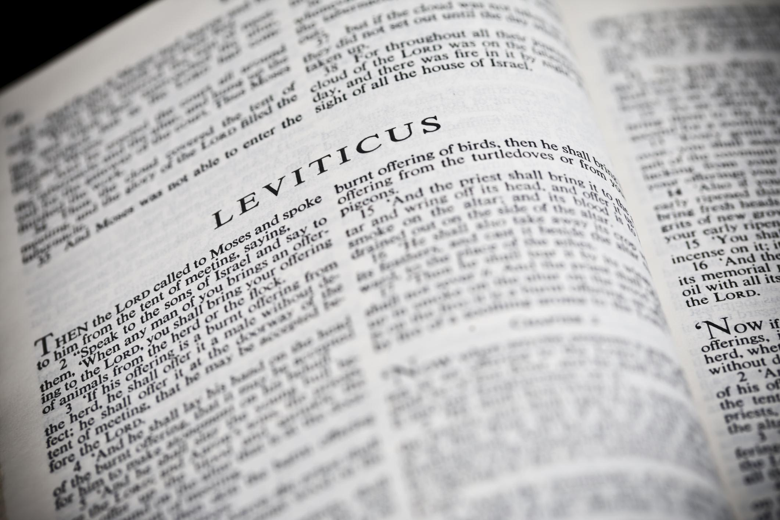
You Shall Be Holy …
A Study of the Book of Leviticus
Two Main Objectives
Encourage reading of “harder” texts
Strive for a closer relationship with God
La Vista - 2016
Joe Works
201-398-8438
Lilpreacherjoe@aol.com

Slide 3
Timeless Lessons
Leviticus 17-18

Slide 4
New Testament Applications
17. Eating blood ⁽¹⁰⁾  John 6:51-60
18. Obedience ⁽⁵⁾  Rom 10:5; Gal 3:12;
Matt 19:17
18. Homosexuality ⁽²²⁾  Rom 1; I Cor 6:9-11
17. Idolatry  Acts 15:19-29; 21:25
17. Eating of blood
17. Meat strangled
18. Immorality  “I am the LORD” ^{(2, 30)}
God Judges Nations: Gen 15:16  Lev 18:3, 24-30
Letter to the Antiochians

