Slide 2
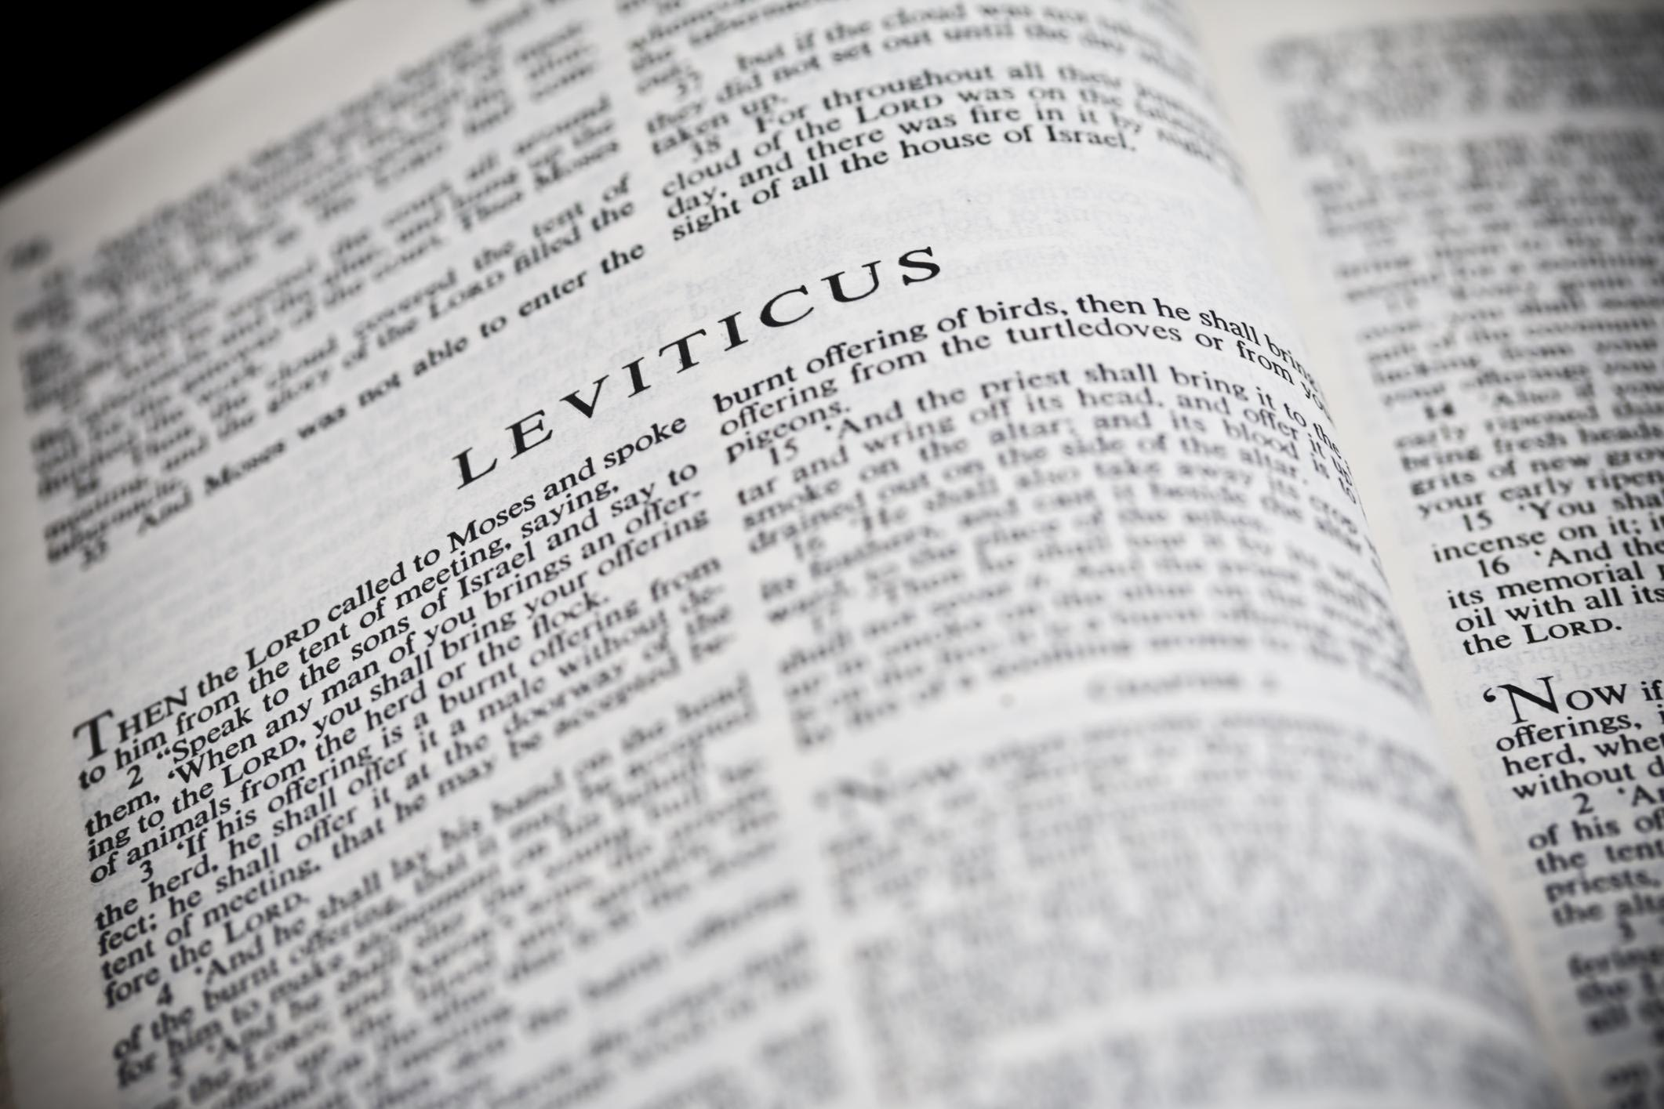
You Shall Be Holy …
A Study of the Book of Leviticus
Two Main Objectives
Encourage reading of “harder” texts
Strive for a closer relationship with God
La Vista - 2016
Joe Works
201-398-8438
Lilpreacherjoe@aol.com

Slide 3
Glorify Thy Name
Leviticus 8-10

Slide 4
Institution of the Priesthood
A heritage of heroes
“Aaron and his sons” (chapters 8-9)
“as the LORD commanded” (8:36)
“sons of Aaron” “He had not commanded them” (10:1)
Week of consecration (8:33-36)
Timing is everything (16:1-2; 12-13)
A response to God’s fire (9:23-10:1)
Fire for fire (10:1-2)
Shouting to silence (9:24; 10:3)
No one is indispensable
Remember: We are a royal priesthood (I Peter 2:9-10)
To God be the glory

