Slide 2
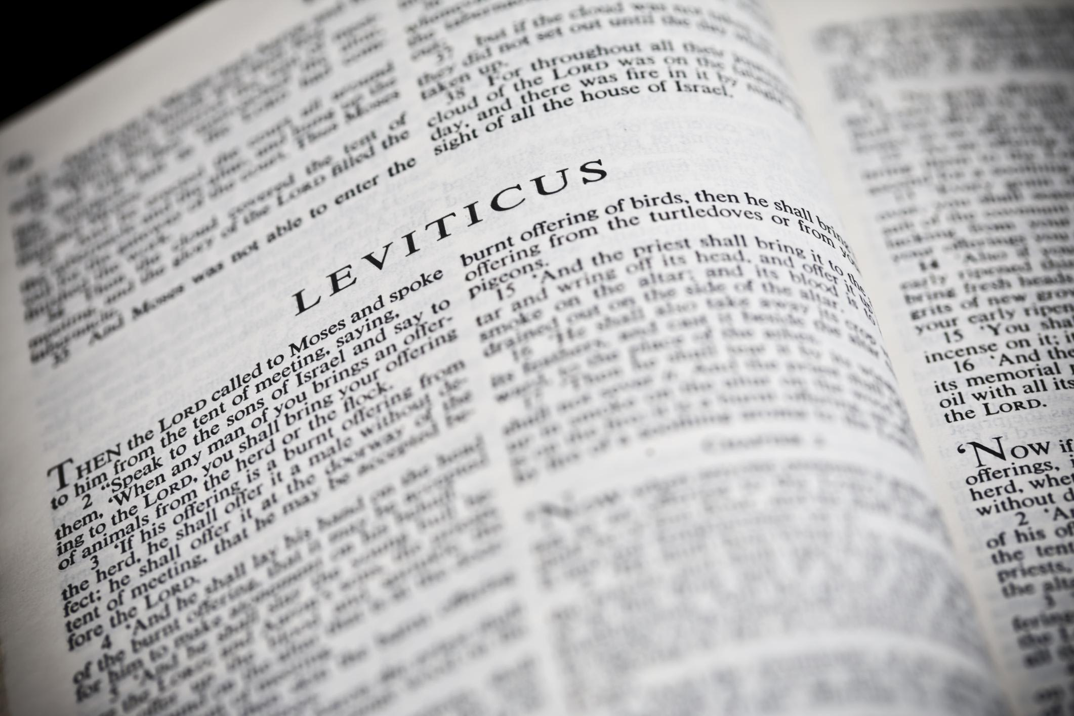
You Shall Be Holy …
A Study of the Book of Leviticus
Two Main Objectives
Encourage reading of “harder” texts
Strive for a closer relationship with God
La Vista - 2016
Joe Works
201-398-8438
Lilpreacherjoe@aol.com

Slide 3
Accepted by God
Leviticus 1-7

Slide 4
Those Boring Sacrifices
“for the children of Israel on Mount Sinai” (27:34)
Burnt Consecration 1; 6:8-13
Grain Dedication 2; 6:14-23
Peace Communion 3; 7:11-21
Sin Guilt 4:1-5:13; 6:24-30
Trespass Restoration 5:14-6:7; 7:1-10

Slide 5
A Sweet Aroma to the LORD
1:9, 13, 17; 2:2, 9, 12; 3:5, 16; 4:31; 6:15, 21
Noah’s sacrifice Genesis 8:20-21
Offering of Christ Ephesians 5:2
The contribution Philippians 4:18
Singing Hebrews 13:15
“I beseech you therefore, brethren, by the mercies of God, that you present your bodies a living sacrifice, holy, acceptable to God, which is your reasonable service.” Romans 12:1

Slide 6
Why did they offer to God?
The LORD accepts with pleasure whoever comes into his presence by substitutionary atonement through the shedding of blood.
Those who are loyally dedicated to the covenant will offer themselves and the best they have to the LORD.
Those who surrender their hearts to God and come before him on the basis of the shed blood of the sacrifice may celebrate being at peace with God (in a communal meal).
God will restore the sinner who appeals to him for forgiveness on the basis of the purifying blood of the sacrifice.
Anyone who becomes aware of obligations left undone or impure contacts left unpurified must make confession and find forgiveness through God’s provision of atonement.
Allen P. Ross (Holiness to the LORD) (emphasis mine)

Slide 7
What will you offer to God?
Burnt 1:4 Atonement (51/99 times)
Grain 2:13 Salt of the covenant (2 Chr 13:5)
Salt of the earth (Matt 5:13)
Peace 7:12 Sacrifice of thanksgiving
Sin 4:13 Unintentional sins
4:13, 22, 27:5:1, 4, 15, 17; 6:1
Sin 4:20ff Priest shall make atonement
4:20, 26, 31, 35; 5:6, 10, 13, 16, 18; 6:7
(Hebrews 10:26-29)
“knowing that you were not redeemed with corruptible things, like silver or gold, from your aimless conduct received by tradition from your fathers, but with the precious blood of Christ, as of a lamb without blemish and without spot.” I Peter 1:18-19

