Slide 2
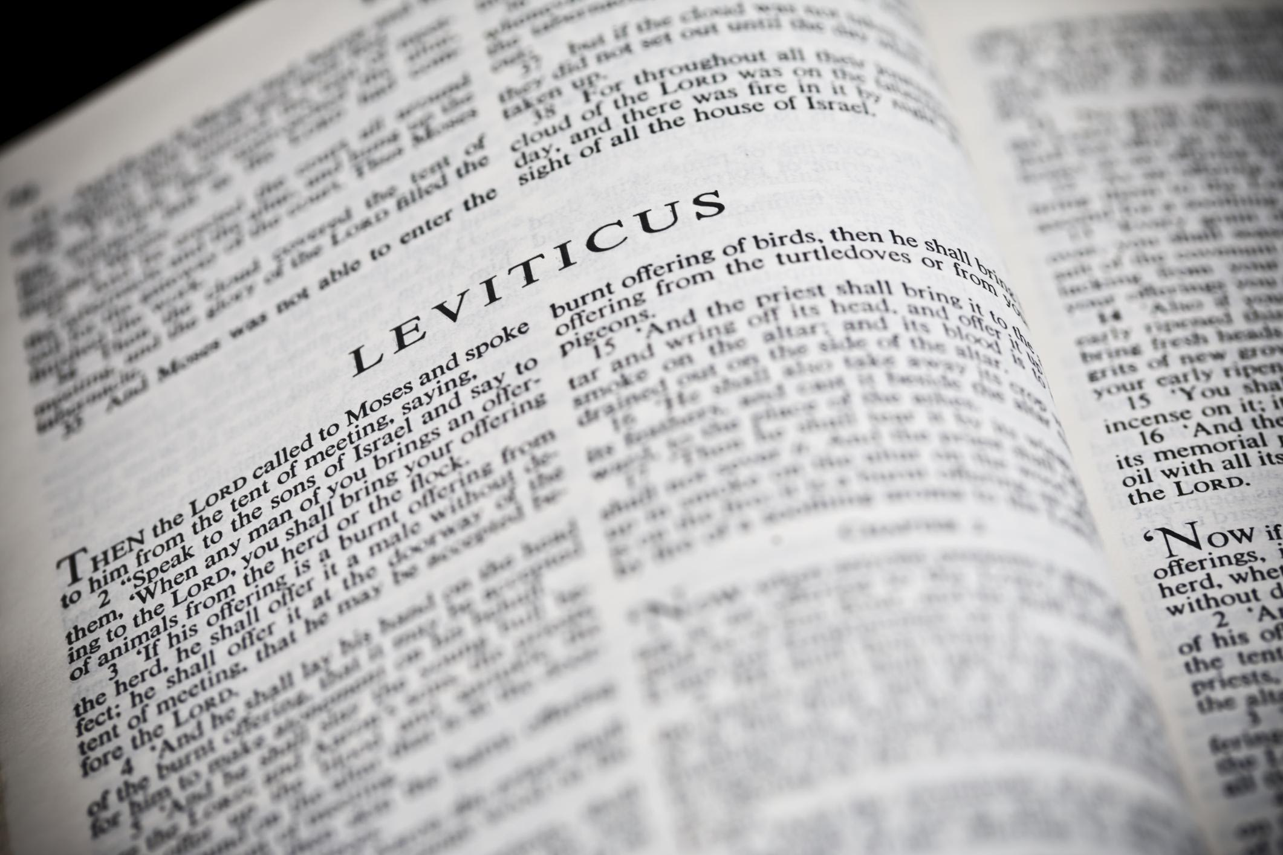
You Shall Be Holy …
A Study of the Book of Leviticus
Two Main Objectives
Encourage reading of “harder” texts
Strive for a closer relationship with God
La Vista - 2016
Joe Works
201-398-8438
Lilpreacherjoe@aol.com

Slide 3
The Book of Leviticus
WHY STUDY THIS STUFF?
Pertaining to the Levites
Sacrifices, Laws, Prohibitions
BORING! BORING! BORING!
The law of the Lord is perfect, converting the soul; the testimony of the Lord is sure, making wise the simple; Psalm 19:7
But his delight is in the law of the Lord, and in His law he meditates day and night. Psalm 1:2

Slide 4

How to come into the Presence of God

Slide 5
“Be Holy, for I am Holy”
“Holy” ☹ holy, saint (noun)
sanctify (verb)
sacred, set apart (adjective)
“Holy, holy, holy” (Isaiah 6:3; Rev 4:8)
“Holy” is used 637 times in the Bible
“Holy” is used 95 times in Leviticus
The most emphasized characteristic of God is talked about most in the book we study the least!

Slide 6
Learning from Leviticus
Lev 11:44-47 clean / unclean animals
Lev 19:2 10 commandments
Lev 20:7, 26 Being cut off
Lev 21:6-8 standard for leadership
Lev 22:32 acceptable offerings

Slide 7
Perfecting Holiness
Holy conduct I Peter 1:13-17
Be separate II Corinthians 6:14-7:1
Thoughts
Dress
Words
Company

Slide 8
You shall be holy, for I the LORD your God am holy.
Leviticus 19:2

