Slide 2
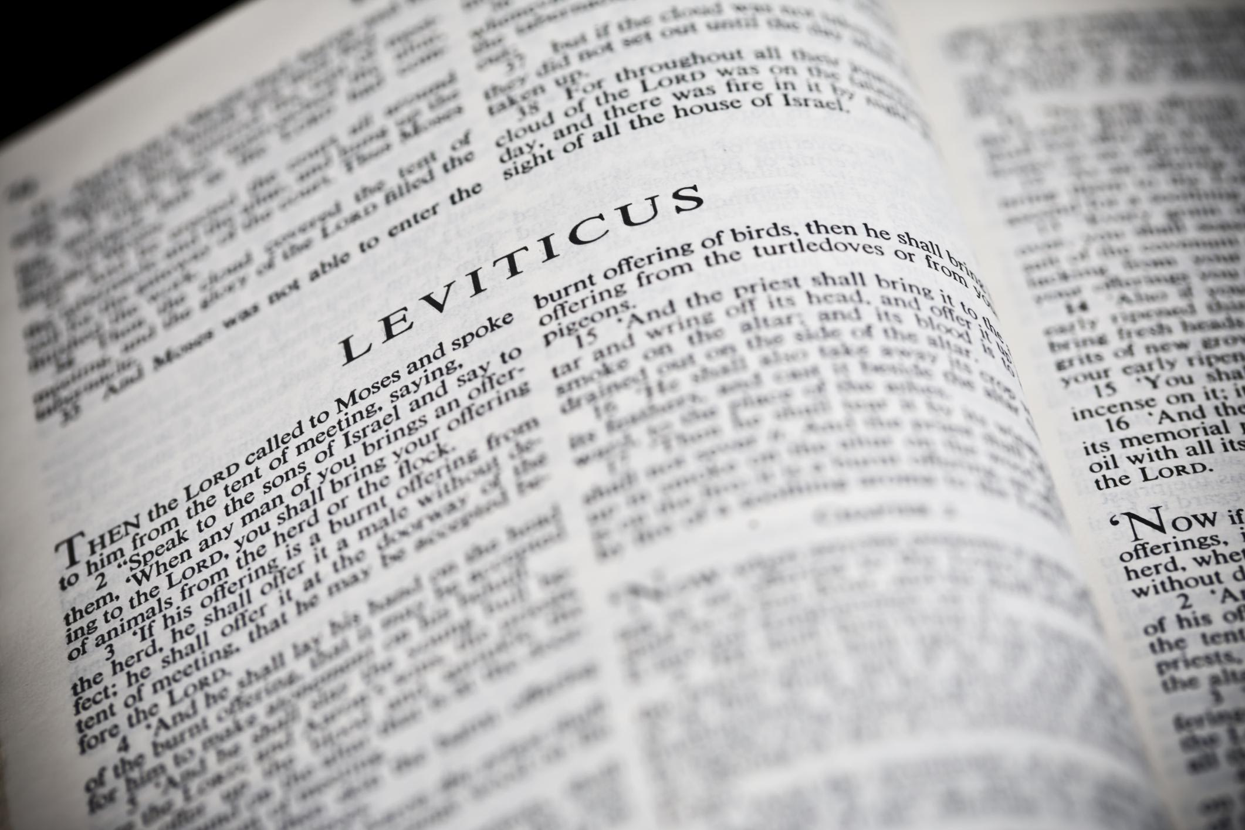
You Shall Be Holy …
A Study of the Book of Leviticus
Two Main Objectives
Encourage reading of “harder” texts
Strive for a closer relationship with God
La Vista - 2016
Joe Works
201-398-8438
Lilpreacherjoe@aol.com

Slide 3
God With Us
A Study of the Tabernacle

Slide 4
The Tabernacle of God
10 cubits
50 cubits
10 cubits
20 cubits
100 cubits

Slide 5
Mt Sinai Events
LORD appears on the mountain Exodus 19
10 Commandments Exodus 20
Covenant made Exodus 21-24
Tabernacle pattern shown Exodus 25-31
Golden calf & covenant renewed Exodus 32-34
Tabernacle built Exodus 35-40
Tabernacle use described Leviticus
Numbering of the people Numbers 1-4
2nd Passover Numbers 9

Slide 6

The Tabernacle of God
Ark of the
Covenant
Altar of
Incense
Table of
Showbread
The Holy Place
Bronze
Laver
Altar of
Burnt Offering
The
Veil
The Most
Holy Place
Golden
Lampstand
Psalm 27:4-6; 42:1-5; 84:1-4; 100

Slide 7
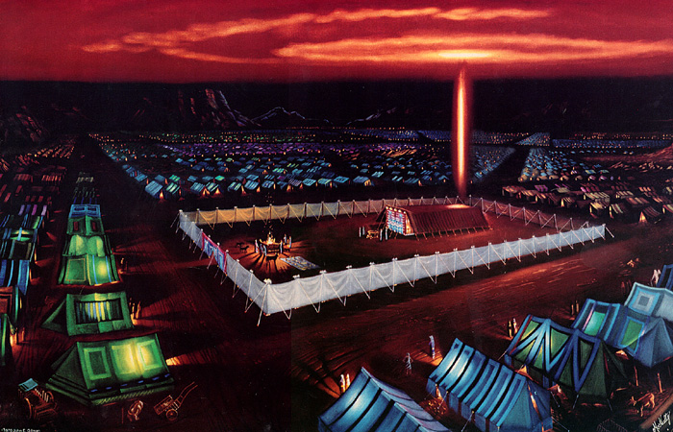

Slide 8
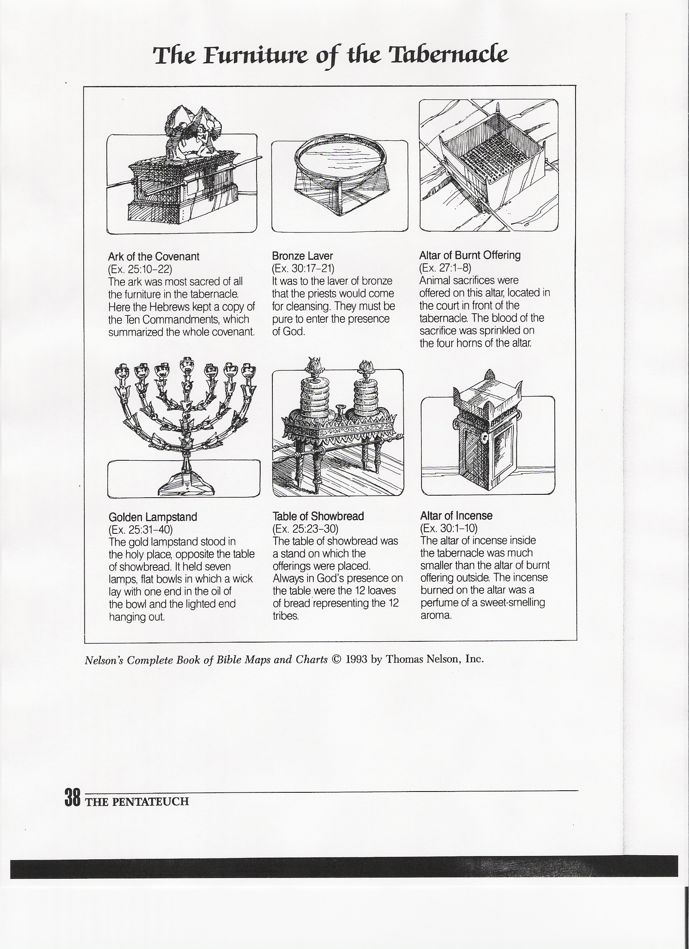
Altar of Burnt Offering
Exodus 27:1-8; 29:38-46; 38:1-7; 40:6; Leviticus 8:15
Horns: Ps 118:27
I Kgs 1:50 (Adonijah) & I Kgs 2:28 (Joab)
See also: Jesus; Leviticus 4:7; Revelation 6:9-11; 9:13

Slide 9
Bronze Laver
Exodus 30:17-21; 38:8; 40:7, 30-32
See also: Jesus: Rev 1:5; Baptism! Hebrews 10:19-25

Slide 10
Table of Showbread
Exodus 25:23-30; 37:10-16; 40:4, 23; Leviticus 24:5-9
See also: Jesus: John 6; David I Sam 21:1-6; Mark 2:25-26

Slide 11
Golden Lampstand
Exodus 25:31-40; 27:20-21; 37:17-24; Leviticus 24:2-4
See also: Jesus: John 9:12; Revelation 1:12, 20; 2:5

Slide 12
Altar of Incense
Exodus 30:1-10, 34-38; 37:25-29; 40:5
See also: Jesus: John 17; Psalm 141:2; Revelation 5:8; 8:3-5

Slide 13
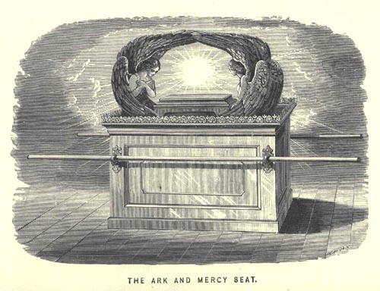
Ark of the Covenant
Exodus 25:10-22; 37:1-9; 40:3
Presence of God
Cherubim
Mercy Seat
Ark of Testimony
See also: Jesus: Rom 3:25; Heb 9:4-5 (3 things in the box)

Slide 14
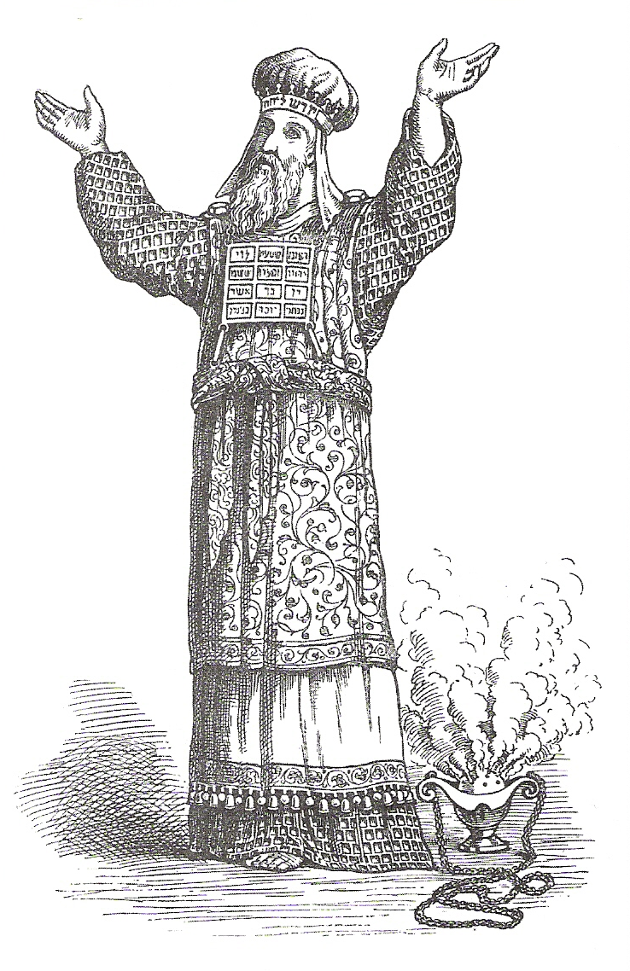
The High Priest & His Garments
Exodus 28; 39:1-31; 40:13-15
See also: Jesus: Heb 8:1

